Slide 1

An Inclusive Education System for an Inclusive Society
John Kearney
Chief Executive Officer
National Council for Special Education

Slide 2





Ministerial Request
Methodology
NCSE Policy Advice
Terms of Reference
Findings and Recommendations
Recent Developments

Slide 3
NCSE Policy Advice Executive Summary
In October 2018, the Minister for Education requested NCSE advice on future educational provision for students in special schools and classes and to make recommendations on the provision required to enable them to achieve better outcomes.

Slide 4

Executive Summary
NCSE was asked to examine and consider:
  Whether placement in specialist settings improves education outcomes for students with special educational needs.
  The increasing demand for special provision
  The operation of these settings and criteria for admission
  If there are students for whom these settings are not working
  Whether UNCRPD has implications for the ongoing establishment of specialist placements

Slide 5
Ministerial Terms of Reference pp. 18 -19
Examine International or local evidence whether that placement in specialist settings brings about better outcomes for students
Examine factors affecting significant growth in special class provision
Why are so many students receiving these recommendations?

Slide 6
A Choice for Ireland
“The choice for Ireland in the coming years will be whether to provide education for some students with special educational needs in special schools and special classes or to evolve into a revised system which will enable all students to attend their local schools.”
Policy advice Paper, December 2022 pp. 7-8

Slide 7
Policy Advice Structure
Chapter 1 – Introduction
Chapter 2 – The Consultation Process
Chapter 3 – The Research Process
Chapter 4 – International Developments
Chapter 5 – NCSE Terms of Reference
Chapter 6 – Recommendations

Slide 8
Chapter 2 – The Consultation Process
  NCSE engaged in 40 Consultations sessions
    Primary, Post Primary and Special schools
    Principals
    Therapeutic supports
    Teacher Education
    Buildings
  Evidence from NCSE Council visits to 13 Irish schools
  International Study Visits to New Brunswick, Portugal, England
  Online Surveys December 2019 to February 2020 – 5000 respondents
  Large consultation session and smaller advocacy engagements

Slide 9
Questions Asked in First Phase of Consultations
If in the future there were no special schools or classes, how would mainstream schools have to be reconfigured to include children who have the most complex needs?
  What arrangements should be in place in a school before a student is placed in a special setting?
  Should a diagnosis of disability be required for a student to join a special school/class?
  What planning should be in place for the establishment of special schools/classes?
  Should fixed-term placements be applicable to all special classes and should there be a mandatory review of all placements at specified points in the placement?

Slide 10
Questions Asked in First Phase of Consultations
Schools report an increasing number of students who, because of significant behaviours of concern, are being excluded; or on shortened school days; or require 1:1 teaching/SNA support in order to be included:
  What are the reasons for these increases?
  What needs to be put in place in schools for these students to be included?
  What should happen when a placement in a special school/class breaks down?
  Does the lack of availability of therapy supports impact on the rate of enrolment in special schools and/or classes?
  Do clinicians (e.g. speech and language therapists, psychologists, psychiatrists, occupational therapists have a good understanding of what happens on a daily basis in mainstream and special schools?

Slide 11
Questions asked in Second Phase of Consultation
Are there benefits to society for all students being educated together in their local school?
  What would need to be in place to have an appropriately supportive environment where all students are educated together?
  If an appropriately supportive environment was in place in schools, what are the advantages and disadvantages to educating all students together in their local school?
  What is the best way forward for students who are currently educated in special schools and classes?
  Are there any other points the NCSE should consider?

Slide 12
Findings - A Significant Divergence of Opinion
Strong supportive views among stakeholders regarding importance of special schools and classes as placement options
Majority agreed:
  Ideally all students should be educated in local school and
Majority also indicated:
  Ireland needs to maintain a continuum of education provision including special classes and schools
  Only these settings are equipped to meet complex needs of students
  Cost-effective to cluster students with complex needs in one setting

Slide 13
A Significant Divergence of Opinion
A minority spoke in favour of truly inclusive settings indicating that specialist settings pose the following challenges:
Limited curricular access
  Limited opportunities to mix with peers who do not have additional needs
  Travelling outside local areas to attend special class/school inhibits opportunities to make connections with their local community

Slide 14
Collated Findings - Special Classes and Schools
Placement in special class/school can be beneficial but can result in long term limitations for students
  Limited curriculum
  Limited post school opportunities
  Some young children never experiencing mainstream education

Slide 15
Collated Findings - Special Classes and Schools
Need for:
  Formal process of assessment to determine placement by relevant assessors
  All possible interventions implemented in mainstream placement first
  Detailed transition to ‘destination school’
  Review of placement rarely happens – no clarity on who should review
  Understand special class planning factors
  Therapeutic supports for students with behavioural difficulties

Slide 16
Challenges to Unlock for Special Schools
Therapy
NQTs
Behaviour support.
01
TPL
Experienced Staff
07
02
06
03
Insufficient funding
Mental Health Supports.
05
04
Meaningful Transitions
SNA supports.
Accommodation

Slide 17
Challenges to Unlock for Post Primary Schools
Therapy
Behaviour support.
01
TPL
07
02
06
03
Insufficient funding
Mental Health Supports.
05
04
SNA supports
Meaningful Transitions
Crisis Intervention.
Transition of complex children

Slide 18
Necessary Steps to an Inclusive System
TPL and certification
Prepare the system
Inclusion from first principles.
An Accessible Curriculum
Towards Inclusion and best practice
Strengthen links between special and other schools
No closures
Maintain specialist placement until system ready
Leadership at political level
Shared vision

Slide 19
Necessary Steps to an Inclusive System
Meaningful assessment for all children
Access to Assessment
Resource the system.
Appropriate Materials
Parental and student focused
After School Support
All children enrolled in local school
Over-sight of Enrolment
Detailed plan towards implementation
Success built on implementation

Slide 20
General Conclusions to Consultations
Significantly differing views on how to progress
Some could consider the possibility of an Inclusive Education System
Acknowledgment of the commitment of staff in special class/schools
Consistent pattern to the issues experienced by the education system
Issues to be addressed irrespective of the path taken

Slide 21
UN Committee Observations on UNCRPD Article 24
An Inclusive Education systems requires
  Legislation – to develop resources/policies/strategies and plans in line with the Convention
  Accessible learning environments and adaptations
  Professional Learning opportunities for staff – inclusive pedagogy, curriculum adaptations, ISL and Braille
  Transition pathways for students to facilitate movement between levels of education and focus on lifelong learning
  Issues specific to students deaf/hard of hearing - fully included
  Data management – systems to generate data on students outcomes and experiences

Slide 22
Summary of International Research
NCSE survey of 12 jurisdictions
International Study visits
United Nations Convention
  Different ways countries provide additional supports for children with SEN
  ‘Varied role’ for specialist provision
  Educational provision across 12 administrations included special schools and/or classes
  Inclusive Education can be achieved – wider range of supports required
  UNCRPD ratification provides a context to Inclusive Education for Ireland: A progressive realisation

Slide 23
Progressive Realisation of an Inclusive Education System pp 101-118
Recommendation 1.1. The NCSE recommends the progressive realisation of the Irish inclusive education system where all local schools are enabled to educate all students in their community in line with students’ strengths and abilities.
Recommendation 1.2. The NCSE recommends the establishment of a strategic planning group under the leadership of the Department of Education and the NCSE to further develop the Irish education system through the progressive realisation of the vision of an inclusive school system.

Slide 24
Therapeutic, Psychological and Behavioural Supports
Recommendation 2.1. The School Inclusion Model (SIM) should be expanded nationally to ensure that all schools in the country have access to therapeutic supports
Recommendation 2.2. The NCSE recommends that the strategic planning group should seeks ways to promote the development of a co-professional model that supports professionals using a values based approach.

Slide 25
Therapeutic, Psychological and Behavioural Supports
Recommendation 2.3. The strategic planning group should also work with the Department of Education and the Department of Further and Higher Education, Research, Innovation and Science to ensure a sufficient number of training places for therapists and psychologists arising from the expansion of the school support services in these areas.
Recommendation 2.4. The National Educational Psychological Service should be significantly expanded to ensure that all schools in Ireland have access to a comprehensive educational psychology service to support the inclusion and participation of all students.

Slide 26
Professional Development and Teacher Education
Recommendation 3.1. The strategic planning group should request the Teaching Council to determine and explicitly set out standards for the knowledge, skills, and competencies for all teachers to teach all students, including students with special educational needs.
Recommendation 3.2. The strategic planning group should work with Teacher Education Section, the NCSE and other organisations and services that provide professional learning programmes for teachers (such as Oide, the new Integrated Support Services, Education Centres, Middletown Centre for Autism, and HEIs)

Slide 27
Student Placement and Provision Recommendations
Recommendation 4.1. The strategic planning group should work to develop a structured standard framework to support a shared decision making process on student placement and review.
Recommendation 4.2. The strategic planning group should engage with Department of Education’s Planning and Building Unit and the Centre for Excellence in Universal Design at the NDA to support the implementation of the Department of Education’s building design and construction guidance for universal design standards.
Recommendation 4.3. The strategic planning group should engage with the Department of Education, the NCSE and schools on the development of a national system to support schools to determine, measure and report on student progress and outcomes.

Slide 28
Guidance and Advice for Schools
Recommendation 5.1. Following engagement with the strategic planning group, the Department of Education and the NCSE should provide further guidance to school leaders on the utilisation and deployment of school staff in small, medium, and large schools, in order to support the management and deployment of the range of supports available to schools to meet the inclusive educational needs of all students, including those with special educational needs. This guidance should identify exemplars of good deployment practice for each school size.
Recommendation 5.2. In adopting any new system, the Department of Education and the NCSE should enhance guidance to schools to ensure that teachers are competent and supported in assessing students’ strengths and needs, implementing appropriate education programmes to support the development of students skills for life and effective transition to adulthood.

Slide 29
Curriculum and Assessment
Recommendation 6.1. The strategic planning group should work with the Department of Education, the NCSE, the NCCA and other relevant stakeholders to bring about the development of an inclusive assessment framework to support the identification of the learning needs of students who require highly specialised supports and provision.
Recommendation 6.2. The strategic planning group should request the NCCA to examine and, if necessary, review curriculum frameworks and content at pre-school, primary, and post-primary levels to ensure that curriculums at all three levels are underpinned by a UDL approach; that the curriculums are sufficiently flexible to support the learning needs of all students, including students with special educational needs enabling them to develop skills for life; and that schools have the autonomy to adjust programmes to address the individual needs of their students at all school levels.

Slide 30
Implementation of an Inclusive Education
Recommendation 6.3. The NCSE recommends that the Department of Education should explore the possibility of making an application for assistance through the European Commission’s Technical Support Instrument (TSI).

Slide 31
Stakeholder Expectations of NCSE Service
Consistency
1
Communication
Focus
6
2
Student & Parent & Schools
5
3
Defined Processes
Stakeholder Engagement
4
Integrated Service

Slide 32

TM Allocation by County*
SENO Allocation by County
Donegal
Donegal
1
3
Leitrim
Leitrim
1
Sligo
1
Monaghan
Sligo
1
Monaghan
Mayo
Cavan
Louth
2
Cavan
2
Roscommon
Longford
1
Mayo
2
Louth
Meath
3
Roscommon
Longford
3
Galway
1
1
1
Meath
Westmeath
Dublin
Galway
2
5
1
4
7
Westmeath
Dublin
Offaly
Kildare
Offaly
Kildare
28
1
Laois
2
Wicklow
2
6
Clare
1
Laois
Wicklow
Carlow
Clare
2
5
2
3
Carlow
Limerick
Tipperary
Kilkenny
Tipperary
2
Wexford
Limerick
3
Kilkenny
6
2
Wexford
Waterford
1
4
Kerry
Kerry
Waterford
1
4
3
Cork
Cork
2
18
* 21st TM to be allocated in the foreseeable future

Slide 33


Inclusion Teams
Multi-Disciplinary
TQM Op Ex
Evidence Based TPL
Scope of Practice
Student Co-Production
Research Based
Responsive
Reliable
Empathic
Assurance

Slide 34
NCSE School Planning Visit
04
02
SNA Review and SENO Support
School Relationship & Students
05
Your Concerns
03
Accommodation Profile
01
School Learning Needs

Slide 35
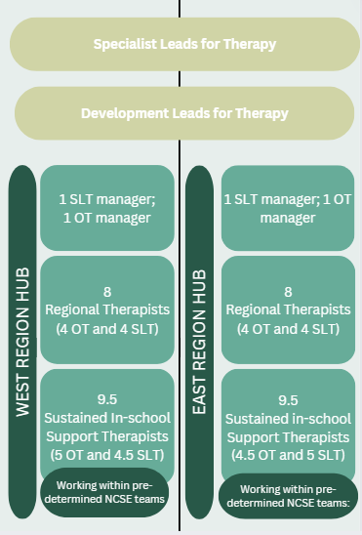
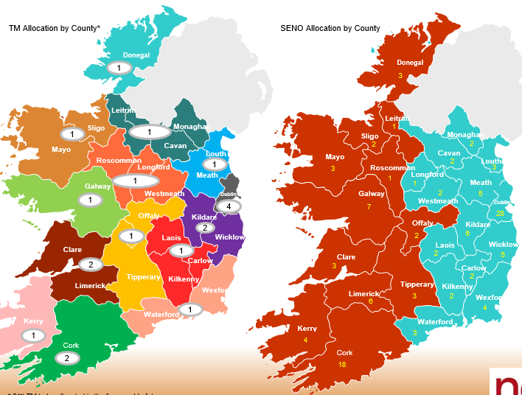
NCSE Therapy Expansion
Staffing
Notes:
Clare/limerick hub – option for sub-hub in another area depending on recruitment
Decision on schools for Sustained in-school therapy based on team and therapist location – resource driven decision making
Requirement for therapists to attend hub twice a week
Add in BG/Senior/total numbers
Need to decide what teams will access sustained support initially- in advance of job descriptions/advertising posts
Ratio Senior-Basic grade/ RTT only Seniors – do the maths
Workforce planning – supervision of student therapist, ensuring university courses will support this model of support
Need to develop a workforce for the long term - therapist

Slide 36



NCSE VISION – DELIVERING INCLUSION
Thank you

