Slide 1
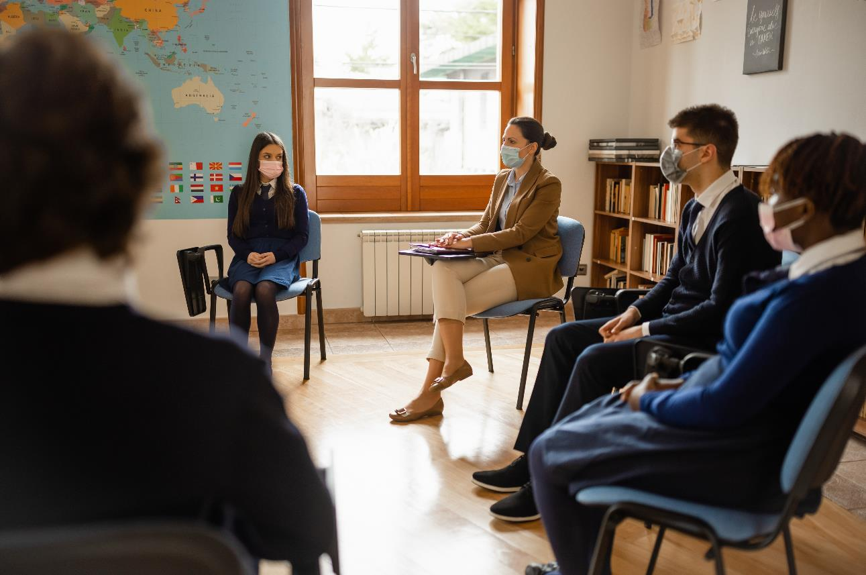

Supporting teachers, supporting schools.
April 2022
REF : 572422/CM

Slide 2

Research Objectives and Methodology
The research objectives were twofold: (I) to inform ASTI's ongoing campaign for ensuring safe schools and promoting teachers’ welfare as we emerge from the pandemic. (II) to identify factors impacting on teacher supply and retention.
Why?
How
Many?
2,565 which represents a response rate of 18.6% - a strong response. (Sample of 13,771 members). The margin of error from this sample size within this population is +/- 1.7%
Who?
A random sample of c14,000 ASTI members – both teachers and principals – for whom ASTI has a valid email address.
When?
March 2022
How?
Online questionnaire, sent by RED C Research to the 13,771 ASTI members on email database.

Slide 3
Principal Findings

Slide 4
Principal Findings
Teacher recruitment is facing a crisis
There is a crisis in teacher recruitment at two levels: the immediate availability of certain subject teachers to schools and the declining attractiveness of teaching as a profession. Almost all principals (93%) reported that their school had experienced difficulties in recruiting staff since August 2021: 67% had a lot of difficulties, 26% had a little.
These difficulties are manifested in the fact that since August 2021, 84% of principals reported that there have been situations where no teacher applied for an advertised teaching post.
Over half of all principals – 55% – reported that their school currently has unfilled vacancies due to recruitment difficulties. The top three subjects with recruitment difficulties are Irish, maths and home economics.
Principals identify a number of factors they believe are impacting on teacher supply. Chief among these is the inadequate number of teachers graduating in certain subjects, the high cost of the two-year master’s degree teaching qualification (PME) and the decline in the attractiveness of teaching as a profession.
In the current school year, almost 9 out of 10 principals stated that situations had arisen in their school where no substitute teacher cover was available to cover for absent teachers. In these circumstances, the most common response was for the principal or deputy principal to ‘stand in’ (92%), employing either a student teacher (81%) or an unqualified teacher (68%).

Slide 5
Teacher wellbeing, workload and work satisfaction
More teachers rated their wellbeing as poor (34%) compared to good (28%). Only 3 in 10 teachers rate their wellbeing as good or very good. For over a third of teachers, their wellbeing was rated as fair (37%).
More teachers identified workload and work intensity as having a negative impact on teacher wellbeing in their school than the COVID-19 pandemic. Over 7 out of 10 teachers identified workload (74%) and work intensity (73%) as the main factors negatively impacting on wellbeing. Heavy workload is underscored by the fact that most teachers – 89% – have full-time teaching hours.
Teacher wellbeing was also affected by external events including the pandemic (55%) and negative media narratives about teachers (62%).
The right to disconnect from school e-communications after the school day was the main priority to improve wellbeing (60%), followed by more professional time, i.e., non class-contact, during the school day (55%) and smaller classes (51%) were prioritised by teachers as key to improving wellbeing. Over half of teachers (58%) stated that their Board of Management did not put in place specific measures to support teacher wellbeing.
Principals were also concerned about teacher wellbeing. While most felt that teacher wellbeing was reasonably good in the circumstances (81%), many were also worried that individual members of staff were manifesting low levels of wellbeing (64%). The majority of principals (67%) concurred that workload was negatively impacting on teachers’ wellbeing.
Work satisfaction levels among teachers is low – just half (50%) indicating satisfaction compared to last year’s higher rating (63%).

Slide 6
Maintaining a safe working environment post-pandemic
The key recommendation from teachers for a safe working environment is smaller classes to reduce over-crowding (77%). Adequate work space for teachers – as distinct from using the staffroom – is also important (71%) followed by a strong cleaning regime in the school (67%). Improvement to the air conditioning/ventilation systems is also important (58%). Less than half of teachers (43%) stated that their schools had installed HEPA-quality air filters to help prevent the spread of COVID-19.

Slide 7
Principals report recruitment difficulties are widespread - over half of schools currently have unfilled vacancies
Teacher Recruitment
(Base: all principals, n=69)
A situation where no teacher applied for advertised teaching post
Currently have unfilled vacancies
Experienced teacher recruitment difficulties
Yes – a lot
Yes
No
Yes
Yes – a little
No
No
Has your school experienced teacher recruitment difficulties since August 2021?
Since August 2021, has there been a situation where no teacher applied for an advertised teaching post in your school?
Does your school currently have unfilled vacancies due to recruitment difficulties?

Slide 8
Lack of graduate teachers in certain subjects identified as a key reason for supply difficulties
(Base: all principals, n=69)
Primary causes of teacher recruitment difficulties
Not enough teachers graduating in certain subject areas
Cost of 2-year PME is discouraging graduates to enter the teaching profession
Teaching as a career is not sufficiently attractive anymore
Unequal pay
Qualified teachers are moving out of teaching into other careers
Cost of local accommodation is a deterrent to working in my school
Workload and intensification of teachers’ work
Not enough teachers qualified to teach in Irish-medium schools
Other
In your opinion, which of the following, if any, are the primary causes of teacher recruitment difficulties at present?

Slide 9
Most principals have had situations with no substitute available, with a range of solutions being implemented
(Base: all principals, n=69)
Situation where no substitute teacher/s was available
How principals managed without substitute teachers / supervisors
Principal/Deputy Principal stood in
Student teacher/s paid to provide cover
Non-qualified teacher/s employed
Teachers on Supervision and Substitution rota re-deployed to meet the contingency
Class/es sent home for remote teaching
Yes
No
Since August 2021, has there been a situation where no substitute teacher/s was available to provide substitute teaching for absent teacher/s?
Please select from the list below how you have managed without substitute teachers / supervisors?

Slide 10

Irish and maths are the subjects with most recruitment difficulties
(Base: all principals, n=69)
What are the top 3 subjects in which your school has experienced recruitment difficulties since August 2021?

Slide 11

Smaller classes, work spaces for teachers and strong cleaning regimes are key
(Base: all teachers, n=2,496)
Necessary to ensure schools remain a safe working environment post-pandemic?
Smaller classes to reduce overcrowding
Adequate work-space for teachers
Strong cleaning regime in school
Adequate staffroom/canteen space
Improve air conditioning/ventilation system
Upgrade toilet/sanitary facilities in the school
Extend size of communal spaces in the school
Adequate canteen facilities for students
Install HEPA air purifiers
Improve school heating system
Improve leisure/walking space on school grounds
Ensure classrooms are sound-proof
Other
None of these
Which of the measures below are necessary to ensure a safe working environment post-pandemic ?

Slide 12
Less than half of schools installed HEPA filters
(Base: All teachers – n=2,496)
Don’t know
Yes
No
Did your school install HEPA-quality air filters to help prevent the transmission of COVID-19?

Slide 13
Workload and work intensity are the main factors impacting on teacher wellbeing
Teacher Wellbeing
(Base: all teachers, n=2,496)
Main factors currently impacting on teacher wellbeing in your school
Workload
Increasing work intensity
Negative media narrative about teachers
Pandemic and its impact on school life
Constant innovation and change in education
Curriculum changes
School inspections/evaluations
Quality of relationship with school management
Class size
Differentiation challenge in the classroom
Concerns about students' wellbeing/welfare
Quality of relationships among staff
Unequal pay for equal work
Challenge of teaching students with special educational needs
Classroom discipline/negative student behaviour
Family issues/home life
Quality of relationships with parents
Other
Irrespective of how you answered the previous question ,what are the main factors currently impacting on teacher wellbeing in your school?

Slide 14
Right to disconnect is key priority
(Base: All respondents – n=2,496)
Has school board implemented specific measures for teacher wellbeing?
Most important to support teacher wellbeing
Right to disconnect from communications outside of school day
More professional time during the school day
Smaller classes
Quality communication from school management
Less administrative duties
Reduced class-contact timetable
More supportive school management
Effective implementation of school discipline/student behaviour policy
More supports for students with special educational needs
More resources for my subject area
More CPD to help me respond to diversity in the classroom
Effective implementation of school anti-bullying policy
Other
None of these
Yes
No
Don’t know
Has your school Board of Management put in place specific measures to support teacher wellbeing in the current school year?
Which of the following are most important to support your wellbeing?

Slide 15
A majority of teachers looked to colleagues for support
(Base: all teachers, n=2,496)
Actions taken to support your wellbeing during the current school year
I spoke to colleagues
I disconnected from work emails/communication after my working day
I took new action to support my physical health
I took new action to support my mental health
I obtained GP/medical advice
I spoke to my principal/deputy principal
I obtained professional advice for my mental health
I contacted ASTI Head Office for assistance on my issue
I contacted the Spectrum Life/employee assistance programme
Other
None of these
Which of the following actions, if any, have you taken to support your wellbeing during the current school year?

Slide 16
A third of teachers rate their sense of wellbeing as poor or very poor
(Base: all teachers, n=2,496)
Sense of Wellbeing
Very good
Good
Fair
37%
Poor
Very poor
NET: GOOD | 28%*
NET: POOR | 34%
*= Figures have been rounded to the nearest %
Over the course of this school year, how would you rate your sense of wellbeing?

Slide 17
Overall Job Satisfaction
(Base: All teachers – n=2,496)
Teacher job satisfaction has significantly declined in the past year
2022
2021
Very Satisfied
63%
50%
Satisfied
Neither
22%
15%
Dissatisfied
28%
22%*
Very dissatisfied
*= Figures have been rounded to the nearest %
Taking into account your current work duties and work environment, how satisfied or dissatisfied are you with your job?

Slide 18
Principals’ views on teacher wellbeing
School Leadership and Wellbeing
(Base: all principals, n=69)
Staff wellbeing is, in the circumstances, reasonably good in my school | Workload is having a negative impact on the wellbeing of staff | Some individual staff members are manifesting low levels of wellbeing | I am concerned about the wellbeing of my staff, but I am unsure of what measures can be taken to address this collective problem | Staff wellbeing has deteriorated in my school because of the pandemic | Some individual staff members have been/ are on sick leave due to stress/mental health issues
NET: AGREE
81% | 67% | 64% | 51% | 49% | 35%
Strongly agree
Agree
Neither agree nor disagree
16%
14%
23%
22%
32%
13%
Disagree
Strongly disagree
NET: DISAGREE
3% | 19% | 13% | 28% | 19% | 52%
Please select how strongly you agree or disagree with each of the following Staff Wellbeing Statements.

Slide 19
Principals’ views on teacher wellbeing
(Base: all principals, n=69)
Most important in terms of promoting teacher wellbeing
Ensure teachers have adequate resources for classroom teaching
Consultation with staff on proposed changes which impact on workload and teachers’ time
Strong dignity at work policy
Improved communication with staff
Identify stressors in our workplace and develop responses
Promote whole-school approach to better work-life balance for staff
Implement a ‘right-to-disconnect’ policy on communication from school after the end of the school day and at weekends
Reduce teacher workload
Other
None of these
Which of the following, if any, are most important for you in terms of promoting teacher wellbeing?

Slide 20
Principals took a number of measures to support their wellbeing
(Base: all principals, n=69)
Actions taken to support personal wellbeing
I took new action to support my physical health
I spoke to colleagues
I spoke to my Deputy Principal
I took new action to support my mental health
I disconnected from work emails/communication after my working day
I addressed workload issues
I obtained professional advice
I obtained GP/medical advice
I contacted the Spectrum Life/employee assistance programme
I contacted ASTI Head Office for assistance on my issue
None of these
Which of the following actions, if any, have you taken to support your wellbeing during the current school year?

Slide 21
Profile of respondents
(Base: all respondents – n=2,565)
Gender
Years teaching
Years as principal
Up to 5 years
Male
Between 6 and 10 years
Less than 5 years
Between 11 and 20 years
Between 5 and 10 years
Female
More than 20 years
More than 10 years
Other
< 0.5%
How many years are you teaching / served as principal?
Your gender?

Slide 22
Employment Status
(Base: All respondents - n= 2,565)
Permanent/CID – less than full-time
Fixed term – part-time
Casual part-time/ substitute
Fixed term – full-time hours
Permanent/CID – full-time hours
What is your employment status?

Slide 23
Employment Status
(Base: all respondents – n= 2,565)
Among those teaching for less than 5 years, almost a quarter have only part-time hours, and less than half
have a permanent contract.
Time Teaching
Permanent– full-time hours
Fixed Term – full-time hours
Permanent / – part-time hours
Fixed term – part-time hours
Casual part-time/substitute
NET: FULL-TIME
78% | 91% | 93% | 94% | 92%
22% | 9% | 7% | 6% | 8%
NET: PART-TIME
What is your employment status?

Slide 24
Most teachers are timetabled to teach full-time hours
(Base: all teachers, n=2,496)
Hours timetabled to teach
Less than full hours
Full-time teaching hours
How many hours are you timetabled to teach?

Slide 25
Type of School
(Base: All respondents - n= 2,565)
Community College (ETB)
Some other type
Community / Comprehensive School
Voluntary Secondary Fee Paying School
Voluntary Secondary School
What type of school do you teach in?

Slide 26
Posts of Responsibility
(Base: All teachers- n=2,496)
Around 1 in 3 have a leadership post in addition to their teaching duties.
No Post of Responsibility
Assistant Principal 2 / Special Duties Post
Assistant Principal 1
Time Teaching
Do you have a Post of Responsibility?

Slide 27

Over a third have an unpaid additional role in their school
(Base: All teachers with no post – n=1,516)
Have an unpaid role in the school?
Yes
No
Do you have an unpaid role in the school (i.e., not in the Post of Responsibility structure)?
Please describe the nature of your unpaid role in the school.

Slide 28
Summary

Slide 29
Thematic Summary
Note: This section is based on the replies to the open question, “Looking to the future, what changes would you like to see in your school to improve the quality of your working life”.
Reduced workload and intensification of teachers work.
Reduced workload was identified by almost all teachers as essential to improve the quality of their working lives. Previous ASTI research confirmed that teachers’ average working week was 41 hours: in addition to weekly teaching timetables of 21 hours and 20 minutes, teachers are spending an additional 20 hours on preparation for teaching.¹ In this survey, almost all teachers (89%) have full-time teaching. This typically involves 32 class periods per week. Class periods are of a minimum 40-minutes duration. With an average of 25 to 30 students per class, teachers are interacting with up to 200 students per week.
Class size was identified by most teachers as deeply problematic. Large class size by definition means high workload in terms of preparation for the class, setting and marking homework and record keeping. It also impacts on the intensity of the teaching itself as teachers are teaching diverse classrooms. Curriculum changes such as the introduction of two Classroom Based Assessments for all Junior Cycle subjects and short courses have also impacted significantly on workload. In this regard, the 40-minute per week professional time allocation to each teacher is viewed as utterly inadequate. Most teachers stated that significantly more professional time will be required to engage with curriculum change at Senior Cycle.
¹
ASTI 2018 Teachers’ Work: Work Demands and Work Intensity

Slide 30
Attractiveness of teaching as a profession
A concerning theme in teachers’ comments was their belief that teaching was no longer an attractive profession for young graduates and, indeed, serving teachers. Several factors are referenced as negatively impacting on perceptions of the profession. Workload is perhaps the most damaging factor. Not only is a heavy workload challenging over a decades-long career, its impact on wellbeing, morale and motivation is equally deleterious. Teachers stated that the quality of working life is a paramount concern among younger teachers and many long-serving teachers felt that younger teachers were less likely to remain in the profession if this quality was further eroded. Retention is widely perceived as a problem within the profession.
Unequal pay is damaging the attractiveness of the profession and teacher retention. Unequal pay is clearly having a corrosive effect on the overall profession with longer serving teachers expressing similarly negative views as teachers under the post-2011 salary structure. Many teachers are of the view that current teacher supply problems are compounded by unequal pay. There is a widespread perception that unequal pay is undermining the status of the profession.

Slide 31
Teacher Wellbeing
Teacher wellbeing was rated by 1 in 3 teachers as poor or very poor. There is clearly a pervasive sense of malaise in the profession on this dimension of working life. Low levels of wellbeing are primarily attributed to workload and work intensity. The right to disconnect featured prominently in teachers’ responses, many of which stated that they received emails from school management, students and also from parents after the working day and during the weekend. The sense of ‘always being online’ undermines work-life boundaries and adds to the feeling that ‘the work is never done’. Teachers reported feeling frustrated that they never had enough time to achieve what they want to achieve: the latter is a classic symptom of occupational stress.
Teacher wellbeing was invariably impacted by the need for constant vigilance in schools in terms of mask wearing, hand hygiene, physical distancing, etc. The lack of a base classroom was a major source of frustration because it meant reduced class time as teachers travelled to and from classrooms and frequently did not have access to a stock of resources assembled over years. Restrictions in terms of social distancing in staffrooms was widely referenced as having impacted on opportunities for interaction and conversation with colleagues. For many teachers, teaching became a lonely profession.

Slide 32
Keeping schools safe into the future
Many of the teachers’ responses focused on the future. How to keep schools open and safe in the context of another pandemic or other societal shock was a concern. The shift to remote teaching and learning demonstrated the high levels of resilience and digital adaptation among teachers. Teachers articulated that they had learned much during the remote teaching period, in particular the importance of relationships in education and their own fundamental role in supporting students’ learning. Almost invariably, many referred to large class size as inhibiting more innovative practices in the classroom as well as their capacity to engage in the range of teaching methodologies required in diverse classrooms. Teachers also expressed concern about over-crowding in large classes. Schools for the future must be more congenial physical places for both students and teachers with more social spaces, wider corridors and better external facilities such as walkways and space for outdoor activities. Adequacy of work spaces for teachers was a widespread concern: teachers need dedicated spaces apart from staffrooms to work in.

Slide 33
What Teachers Are Saying…
The workload for teachers is constantly increasing with no extra time for teachers to do non-classroom work
Less administration: it is increasing from year to year and the focus on teaching itself is being impacted. Smaller class sizes. Open and transparent communication in school
I’d like to see our school recognised for the high degree of care we provide to our mixed student population. This is a somewhat hidden aspect of our school
Smaller classes and reduced class contact time to allow for prep and planning – not bringing work home
More supports for student wellbeing
A real effort to address teacher workload and burnout
Right to switch off
A proper place to work between classes
Devices for all students: it’s ridiculous that they have to use their own mobile phones. It’s not safe either
Pre-COVID school life was more fun!
A right to disconnect policy – non-existent at the moment
Equal pay for equal work

