Slide 1
Lessons in Organising:
Education activism in an age of crises
ASTI Annual Convention
Wexford, Ireland
11th April, 2023
Professor Howard Stevenson
University of Nottingham

Slide 2

The attractiveness of the teaching profession . . .
A report published by European Trade Union Committee for Education (ETUCE) and the European Federation of Education Employers (EFEE)
Authors: Howard Stevenson and Alison Milner (2023)

Slide 3
The age of crises . . .
Global economic crisis in 2008 and its 2023 variant the cost of living crisis
Public health crisis – Covid 19 and the global pandemic
Geo-political crises - conflict, war and mass migration
Environmental crisis and the existential threat to a sustainable planet

Slide 4
The crisis of teacher supply . . .
‘The teaching profession has been going through a vocational crisis for some years now, attracting fewer young people and losing others who have been trained to become teachers. Many European education systems are now suffering from shortages of teachers. This can significantly hinder the delivery of quality teaching and learning.’
(Teachers in Europe: Careers, Development and Wellbeing. Eurydice, 2021)

Slide 5
The scale and shape of the problem
Problem | Country
Shortages | BEde, IE, HR, RO, UK-WLS, AL, MK, FR, UK-SCT, NO, DE, LV, LU, NL, CZ, AT, PL, CH, BG, EE, HU, SE, IS, BEfr, BEnl, DK, UK-ENG
Shortages and oversupply | LI, EL, ES, IT, LT, PT
Over supply | CY, TR, UK-NIR
Eurydice, 2021

Slide 6
Supply side problems
Problem | Country
ITE shortages (low applications and/or high dropout) | FR, UK-SCT, NO, DE, LV, LU, NL, LT, PT, RS, MT
Teacher dropout | BG, LI
Teacher dropout and ITE shortages | EE, HU, BE, IS, Befr, BEnl, DK, UK-ENG
An ageing teacher population | DE, LV, LU, NL, CZ, AT, PL, CH, BG, EE, HU, SE, IS, LI, EL, ES, IT, LT, PT

Slide 7
Thinking about the ‘attractiveness of the teaching profession’: re-thinking the problem
Work
Working conditions
Remuneration
Work-life balance
Stevenson and Milner (2023)

Slide 8
Thinking about the ‘attractiveness of the teaching profession’: re-thinking the problem
Work
Working conditions
Remuneration
Teachers have high work intensity and low task discretion
Green (2021)
Work-life balance
Stevenson and Milner (2023)

Slide 9
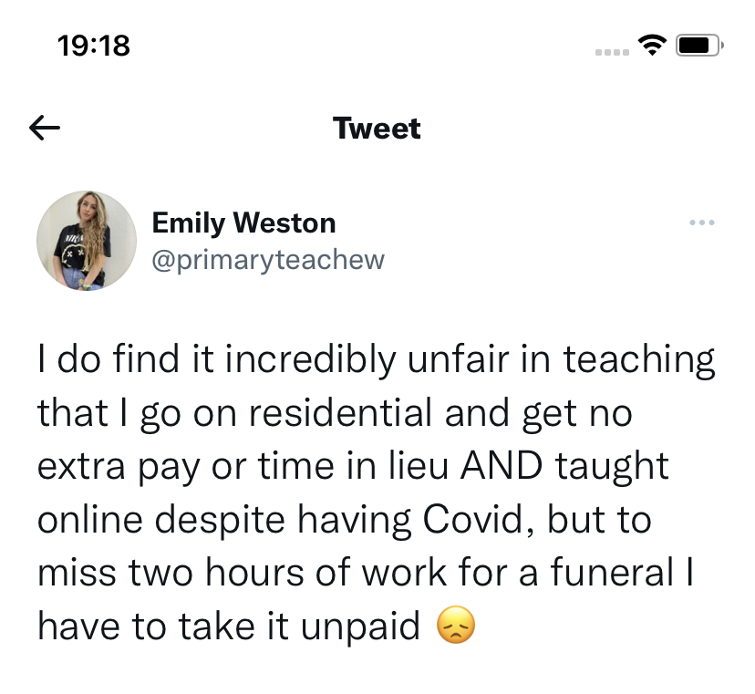
What this looks like . . .

Slide 10



Building strong education unions
Organising teaching: developing the power of the profession (2017)
Your Turn: Teachers for trade union renewal (2020)
Lessons in Organising: what trade unionists can learn from the war on teachers (2023)

Slide 11
Lessons in Organising
Organise at the workplace
Organise around ideas
Organise the organisers

