Slide 1
Responding to NCSE policy advice on inclusion
ASTI Education Conference October 2024
Brendan Doody, Department of Education

Slide 2
Budget 2025 measures
€11.8 billion investment in Education and Schools in Budget 2025
9% increase on Budget 2024
€51 million funding to extend the free schoolbooks scheme
Capitation rate increase (post primary €345 to €386 per student)
Additional 768 special education teachers / 1600 SNAs
A bursary for student teachers to increase the number of qualified Science, Technology, Engineering and Maths teachers in post-primary schools, and continued funding for free upskilling courses for teachers in high-demand subject areas.

Slide 3
Budget 2025 Cont.
Additional 1,000 school posts of responsibility - 2025/26 school year
Increased funding will be provided for Senior Cycle Redevelopment
Junior Cycle and Leaving Certificate students will be exempted again from the usual exam fees of over €100 next summer
The capital budget will increase by over €360 million to €1.3 billion in 2025. Under Project Ireland 2040 some €6 billion will be invested in the education sector over the period 2021-2025.
Support for transitions from primary to post-primary

Slide 4
Selected Special Education Stats
NCSE staffing – additional 161 in 2024 (SENOs / advisors)
NEPS – additional 54 in 2024
Special education teachers – 14,643 (20,000 teachers working in special education) SNAs – 22,091
SET – pupil ratio 16/1
 | 2019 | 2024
Special classes pp | 448 | 997
Percentage of total school population in special settings | 1.8% | 2.9%
Percentage of DE budget spent on special ed | 18% | 26%

Slide 5
What additional measures are in place to support inclusion and inclusive practices in our schools?

Slide 6
Technical Support Instrument (TSI)
EU programme that provides tailor-made technical expertise to design and implement reforms -designed to improve the quality of public services and to reinforce sustainable and inclusive economic growth
The support can be strategic and legal advice, studies, training and expert visits on the ground
Successful application for TSI support - paired with Finland
The overall objective of the action is to foster quality inclusive education in Finland and Ireland, by improving the access, participation and achievement of all children and students within mainstream education settings/schools.
Support is provided by the European Agency for Special Needs and Inclusive Education (EASNIE) and funded through the DG Reform Office

Slide 7
Ireland’s TSI Project – what are we hoping to achieve?
A model of inclusion tailored to the Irish education system which seeks to maximise children’s and students’ access to mainstream primary and post-primary education settings.
Align the Irish education system to the United Nations Convention on the Rights of Persons with Disabilities (UNCRPD), which Ireland ratified in 2018.

Slide 8
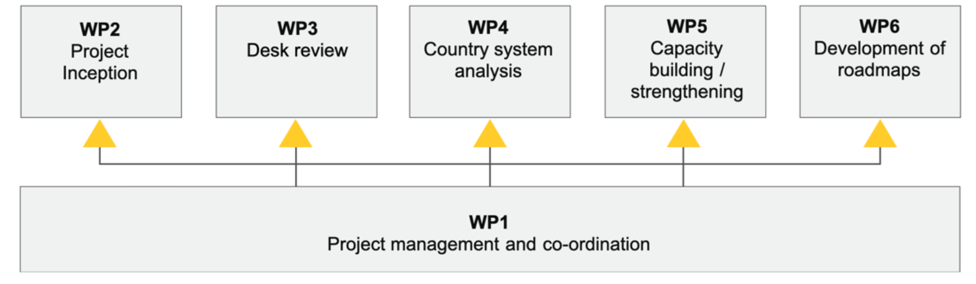

Project Phases/timeline
Autumn 2023 - early 2024
Early-mid 2024
Mid 2024-early 2025
Mid 2025
Autumn 2025

Slide 9
Towards Inclusion
Collaboration between special schools and mainstream schools (22 in 2024 – 40 in 2025)
Provides for collaboration between mainstream and special schools in teaching, learning and assessment practices
Develops synergies in effective teaching approaches for students with Special Educational Needs through Communities of Practice
Funding is provided through the Dormant Accounts Fund and the programme will be subject to an external evaluation.

Slide 10
Nursing Pilot for Children with Complex Healthcare Needs
Partnership with the HSE and NCSE
Purpose - makes nursing supports available to enable children with complex healthcare needs attend school
Extends the HSE Paediatric Home Care Packages for eligible students from their home into the school setting
Programme will be evaluated, and the outcome will inform the provision of nursing support for students with complex healthcare needs into the future

Slide 11
Transitions to after school adult life
Transitions programme involves 40 special schools this year.
Target Group: The programme is targeted at students in senior cycle with the most complex needs and the overarching objective is to ensure that these students make optimal transitions to either Further Education and Training / work / adult disability services.
Supports Provided: Additional resources have been provided to NCSE to oversee the programme. Schools participating in the pilot are allocated an additional 6 teaching hours per week.
Teacher led programme

Slide 12
WALK: Walkinstown Association for People with an Intellectual Disability
Similar to the CES Transitions Pilot but funded through the DAF since 2022 to engage with 170 students in their final 2 years of school, across 10 school sites. (7 Special and 3 post primary)
Off the shelf manualised programme
Aim of the Pilot: To support school leavers with special educational needs to transition to mainstream further education, training, employment and adult services.

Slide 13
Students with Exceptional Ability
Internal working group established to develop policy on students who are exceptionally able or gifted
Recently commissioned a piece of research on current provisions and practices in other jurisdictions.
Consultation with representatives and advocates of gifted students
Saibhriú-Empowering learners with advanced abilities; to foster local collaboration between primary schools and post-primary schools to establish how schools can most effectively work together to support the needs of students that are exceptionally able and how staff expertise and best collaborative teaching approaches can be identified and shared.

Slide 14
Special ed outcomes working group
DPENDR report Monitoring Inputs, Outputs and Outcomes in Special Education Needs Provision, there is currently:
……. no central collection of metrics or monitoring on detailed outcomes for children and young people by the NCSE or the Department.
How can schools use available data to monitor and report on the outcomes attained children and young people with special educational needs?
Is there a way of using aggregated school data and information to gather data at system level on the outcomes attained by children and young people with SEN?
Using data to inform policy and the allocation of resources to support children and young people with special educational needs

Slide 15
SNA Workforce Development Plan
Research to date:
Focus groups with SNAs in May 2023
Focus groups with school leaders on the role of the SNA in January & February 2024.
The first national survey of SNAs in February 2024
Focus groups with teachers on the role of the SNA in September 2024
Five pillars
Review and Development of the SNA role
Establishment of a Quality Assurance Framework
Establishment of a SNA Learning and Development Programme
Supporting SNA Recruitment, Retention and Diversity
Development of a Communications Strategy to ensure optimum communication and collaboration with all stakeholders to achieve the vision of the SNAWDP
Working groups established for each of the five pillars
Work is progressing towards publication in September 2025

Slide 16

Understanding Behaviours of Concern and Responding to Crisis Situations Guidelines for Schools in Supporting Students
Rationale for Guidelines
Calls from parents, teaching organisations, management bodies and advocacy groups
NCSE policy advice
Teacher / SNA leave arising from behaviours of concern
Intended purpose
To enable the creation of safe physical and emotional
environments for all
To address uncertainty for staff on how to respond
when facing crisis situation where there are concerns
regarding physical safety
Notes:
Consultation Process
April 2019 - Online Questionnaire 2,600 respondents
November 2019 – Stakeholder in-person consultation
Covid19 – Aspects of the work were impacted
Early 2023 - draft shared with special schools
April 2023 – Stakeholder in person consultation
Aug / Sept 2023 – additional stakeholder consultation and engagement with advocacy groups
Nov 23 – Feb 24 - The guidelines were trialled in 15 special schools
June – Sep 24 - Trialled the procured training in special schools

Slide 17
Aims of the Guidelines:
Emphasis on:
The importance of positive school climate
Prevention, Early intervention, De-escalation
Voice of student
Parent role
Clarity on:
Seclusion
Restraint
Reporting requirements

Slide 18
Go raibh maith agaibh

